Slide 1





GREEN YELLOW HOUSE
Current Situation
Mariana Ribeiro Martins de Barros
Câmera Brasileira da Indústria da Construção

Slide 2

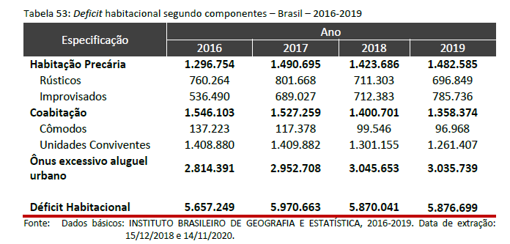
Demand: Housing Deficit
Notes:
Deficit habitacional brasileiro tem três modalidades, habitação precária por condições de saúde, higiene, risco. Coabitacao, onde convivem juntas mais pessoas que o recomendável, Onus por custo de aluguel, onde o valor do aluguel ultrapassa 30 % dos ganhos mensais da famílias.

Slide 3
Green and Yellow House
Start in March/2009 (under the name My House, My Life)
Number of Units produced since 7,5 millions
Financing from a Workers Fund (FGTS)
FGTS is a Fund that belongs to workers and it is provided by about 8% of every formal workers income. This fund can be withdrawal in workers retirement, in order to purchase housing or emergency matters (i.e. Covid 19 health crisis)

Slide 4
Target Population
Until U$ 400/month ----- funding related to Family’s income
Until U$ 520 /month ----- Subsidy over property’s value and interest rates reduction
From U$ 520/month until U$ 720/month ----- subsídios sobre imóvel
From U$ 720/month until U$ 1.600/month ----- funding without subsidy

Slide 5
Resources are distributed under regional criteria
In order to every State Housing Deficit

Slide 6
Subsidy Criteria to Families
Similar groups under even conditions
States based on income
State Capital or Metropolitan Region
Size of municipalities based on population

Slide 7
Subsidy Criteria to Families
Among the context of cities, there are parameters within each Family characteristic:
  percentage of burden over Family expenses
  Size of the Housing Unit
  Number of Family members
  Available Infrastructure

Slide 8
Current Situation
Family income until U$ 420 – government resources, a problemas fiscais estao limitados nos últimos 4
Family Income until U$ 1.600/month – Lost of purchasing power due the increase of supply and hence sales pricing value.

Slide 9
OTHER SHAPES OF SOCIAL HOUSING
LAND REGULARIZATION
Program aims to regularize a large number of properties that were in irregular situation
REMODELING AND IMPROVEMENTS
To regularized property – provide resources for improvements specially the ones regarding health and safety
Families request the service through digital platform, after the approval based on pictures sent by the taxpayer, the construction is paid through money transfer.

Slide 10
OTHER SHAPES OF SOCIAL HOUSING
Social Rental – still under project, due to be launched in 30 days. The entrepreneur invests, manages and has a guaranteed contract for 20 Years with the government.

Slide 11
Thank You!
Mariana Ribeiro Martins de Barros
Câmera Brasileira da Indústria da Construção

